Slide 1
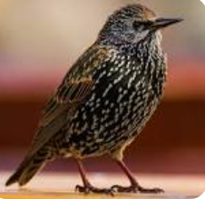
Welcome to Starling class!
Autumn Term

Slide 2
About me and basic information:-
Mrs Dawn Moffat
I am the full time EYFS/year 1 teacher.
I have experience teaching all year groups but within the last 10-15 teaching year 1 and EYFs and specialising in EYFS.
I am available for a brief chat or query the end of the day.
If a longer appointment is necessary, please book through the school office.
Please send emails to me via:- office@fowlmere.cambs.sch.uk
I will respond as soon as possible during working hours.
Our TA timetable is not fixed but currently we have
Mrs Morris 9 – 3pm Wednesday to Thursday
Mrs Parker each day until break time.
Mrs Chilsolme Monday 10 – 3pm
Mrs Raunds Friday mornings.
PE is on Wednesday afternoons. It is run by Premier Sports using our PE scheme, Get Set for PE.

Slide 3
A quick note as the evening was cancelled…..
The children have settled beautifully.
We are a few weeks into term, and the children are already one class.
Our new foundation children have set learning places on the carpet and know them already! They have learnt so much already about the rules, routines and more formal learning behaviours of our setting. They have started learning phonics and know 8 sounds!
Our Year 1’s are fabulous role models! They too have settled into their Year One ‘quiet space’ and more structured learning. They are enjoying learning about The Great Fire of London.

Slide 4
As you are are aware Starling class is composed of Reception and Year 1.
The class has two separate curricula – The National Curriculum for year 1 and the EYFS Framework for Reception children. The curriculum is taught through focused teaching times for each year group and focus groups. This is done to better target the learning of each year group and individual needs.
I see them as one class and they share the main body of the classroom. Early Years have their areas, developing key concepts through exploration and play, whilst the learning environment is more structured for year 1. The Year 1 know this environment as the space for their ‘quiet learning’. Both year groups have challenges suited to their curricula and learning development.

Slide 5
Reception learning environment.
Our continuous provision supports children’s personal, social and emotional development in a number of ways. The provision itself contains high quality resources that encourage social play, turn taking and collaboration. These resources are easily accessible for the children and clearly labelled. We have a variety of excellent books available in the provision that explore emotions and how we react to these. In addition to the physical provision, the adults in the setting contribute to the teaching of children’s personal, social and emotional development. Our EYFS is built upon warm and caring relationships between adults and children. The adults model high quality social play and interactions and support the children to solve social and emotional problems in their play. We have consistent rules and boundaries throughout our setting which support the children’s sense of security.
Communication and language is one of the building blocks for all future learning and consequently it underpins all of the teaching we do in the Foundation Stage. Our continuous provision environment is language rich, not only in the resources themselves, but in the presentation and the adults who facilitate the learning. We foster high quality interactions throughout our learning environments and communicate with the children in an inclusive manner, whilst also striving to extend and develop their communication skills. We place huge importance on the texts available to our children and these have been chosen for a variety of reasons, including being diverse and inclusive; being interesting and exciting; containing a range of excellent vocabulary and exposing children to themes and topics they may not have encountered before. These books are always available in the provision along with supporting resources for independent play. In order to develop the children’s vocabulary, we discreetly teach new words and embed these in the continuous provision.

Slide 6
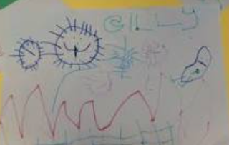
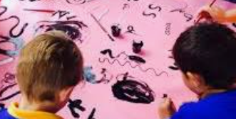
Setting your child up for success.
Self care- dressing, toileting, shoes.
Mark making – paints, pencils, chalks.
Name writing – practice makes perfect!
Reading – books to be sent home in a few weeks once initial phase of phonics has been taught. (Reading and Phonics meeting to follow.)
Learning through play – Active learning.

Slide 7
Year 1 Learning Environment.
Supportive, caring, kind and respectful.
Learning to manage their own behaviour and emotions.
Building confidence.
Learning how to learn – Self efficacy.
Learning to work more independently.
Continuing to develop a positive attitude towards challenges.
Setting your child up for success.
Reading – read to your child, explore new words, listen to your child read (10-15 min daily). New scheme – reading books to be changed on Thursdays. (Reading and Phonics meeting to follow).
Spelling –linked to reading scheme.
Maths games – practice maths skills in everyday situations.

Slide 8




English
Phonics
New scheme – Little Wandle. Daily phonics programme taught to both year groups. Phase 2 – 5.
Reading
Linked to new scheme.
Spelling
Linked to new scheme. Spellings to come home each Thursday in reading books.
Writing
Following the new Writing Framework 2025.
Based on key texts – Reception – beginning with Nursery Rhymes.
In Reception, keeping things simple and doing it well. Oral composition of ideas, developing writing (instruction) – learning movements needed to form letters on a range of scales and surfaces. Hold and control of pencil, correct position for writing, progressing to lessons and practise. Writing within play and environment. Letter formation linked to phonics.
In Year 1 - sitting at tables, orally composing sentences and re-phrasing if necessary. Key component initially construction and understanding of sentences. How to construct a sentence. Moving onto more complex sentence construction and ideas. Writing based around key books, considering text types and purpose of text.

Slide 9


Maths
Maths sessions are delivered daily to both year groups. We follow the White Rose Scheme.
Secure grasp of mathematical concepts and a deeper understanding– through lots of manipulating resources, attention to key mathematical knowledge and understanding the structure of number in both year groups before applying this to written maths.
Using practical, written and mental strategies.
Developing reasoning and mathematical thinking.
Developing accuracy, fluency and efficient methods – to minimise counting and inaccuracy. In Reception, the key concept is subitising and accurate counting. In Year 1 – using knowledge of subitising & securing number facts. Counting in 2, 5 and 10’s.

Slide 10

Science
A weekly session is delivered.
In EYFS, science comes under the category ‘Knowledge and Understanding’ of the World.
Developing scientific thinking skills – observations, questioning, hypothesising, evaluating.
Performing simple tests, gathering data, recording results.
Acquiring a body of knowledge and understanding.
This term we will be studying Seasonal changes followed by Our Bodies: our senses.

Slide 11



In EYFS history come within the category, ‘Knowledge and Understanding of the World’. We look at Me and My Family and People Who Help Us. We look at beginning to make sense of the children’s own life story and images of familiar situations in the past such as at home or school. We begin to get a sense of the ‘past’. People in the community such as police, fire fighters, nurses etc are
Year 1 – The Great Fire of London. Also building upon this sense the children have begun to acquire of the ‘past’. Looking at timescales, changes, significant events and people.
Reception - Within Knowledge and Understanding of the World. Where am I? My home within the wider local area. Aerial views of local area and school.
Year 1 – locating where they live on an aerial photograph and recognising features within a local context. Creating maps using fieldwork, learn geographical vocabulary.

Slide 12

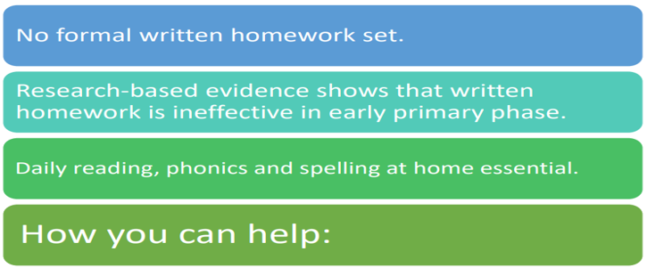
Please,
Hear your child read daily.
Encourage children to talk about what they have read.
Practise maths skills in everyday tasks. Eg “Each person needs a knife and a fork, how many knives and forks do we need altogether?”
Play games and complete puzzles to build concentration and turn taking. Lots of games and puzzles support mathematical concepts and understanding.

