Slide 1

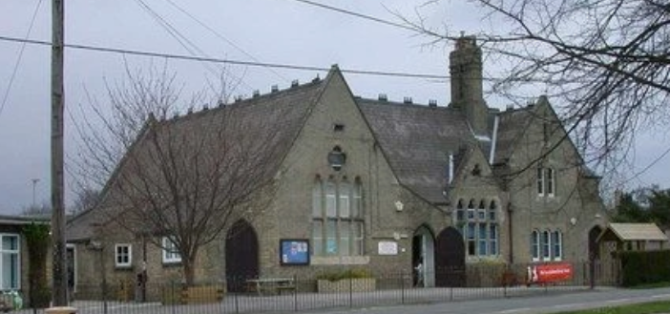
Welcome to
Meet the teacher 2026-27

Slide 2

Welcome to Fowlmere Primary School
Meet the Starling team
• Class Teacher – Mrs D Moffat
• Teaching assistants – part time – Mrs Rands & Mrs Morris.
..Also currently Mrs Chisholme.

Slide 3

PE Days
Our PE days are:-Monday and Fridays.
Please can you ensure your Child has their PE kits in school on these days, and if possible, can you remove their earrings.
PE kits – White t-shirt, blue or black shorts/jogging bottoms, trainers/plimsolls.
Please make sure your child’s name is on the clothing.
Notes:
Add vision

Slide 4
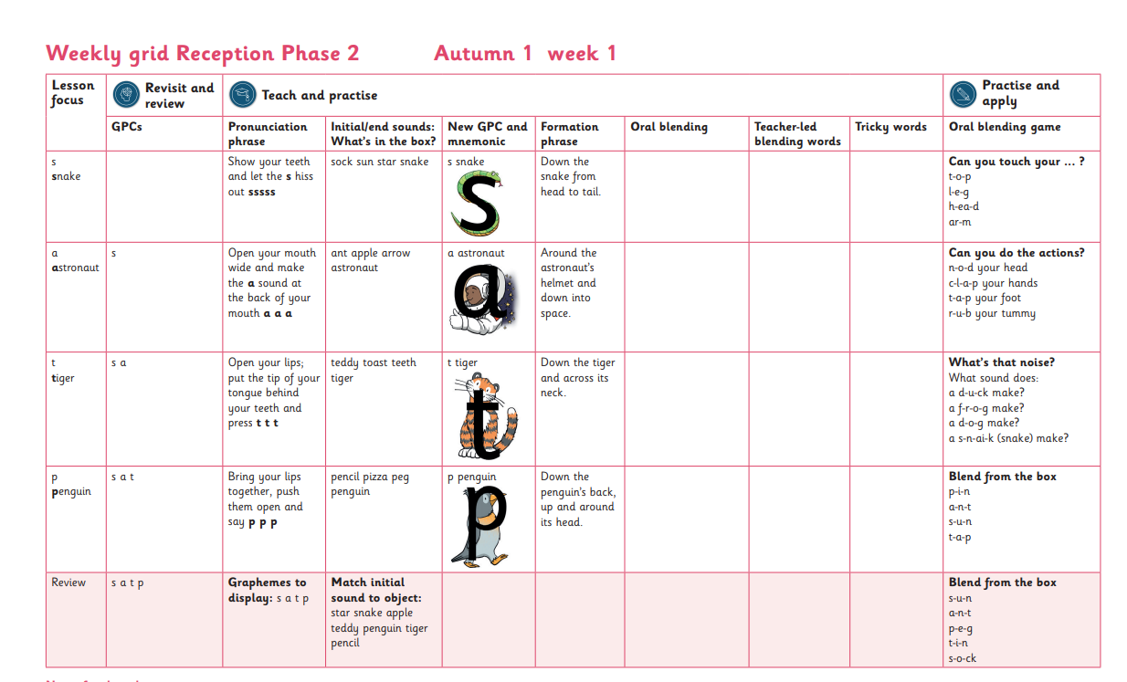

Phonics
We teach phonics daily using a scheme called Little Wandle.
What a session looks like.
Reception

Slide 5
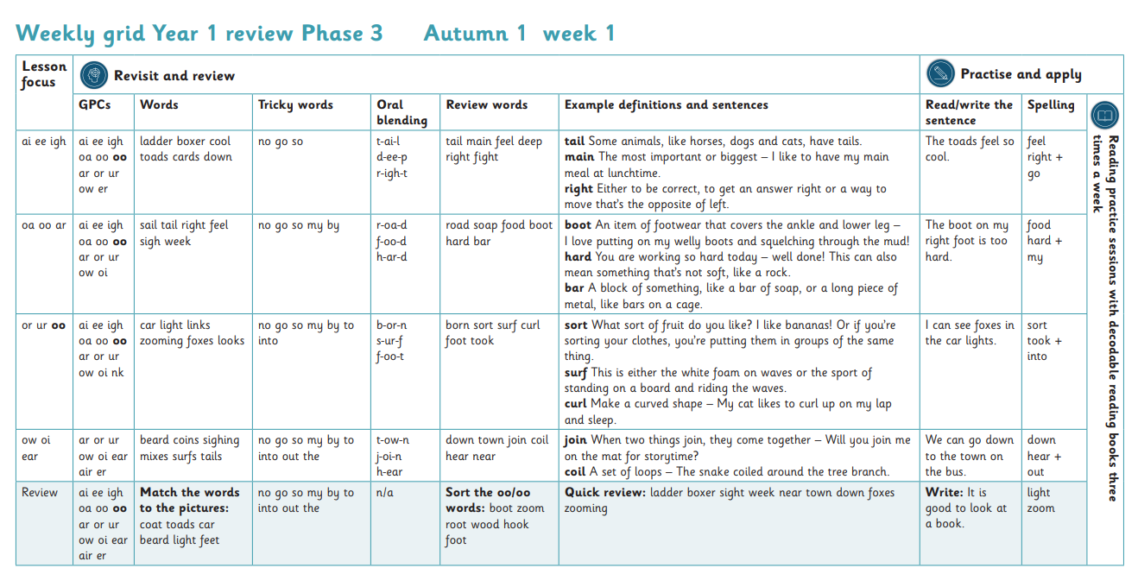
Phonics
We teach phonics daily using a scheme called Little Wandle.
What a session look like.
Year 1

Slide 6
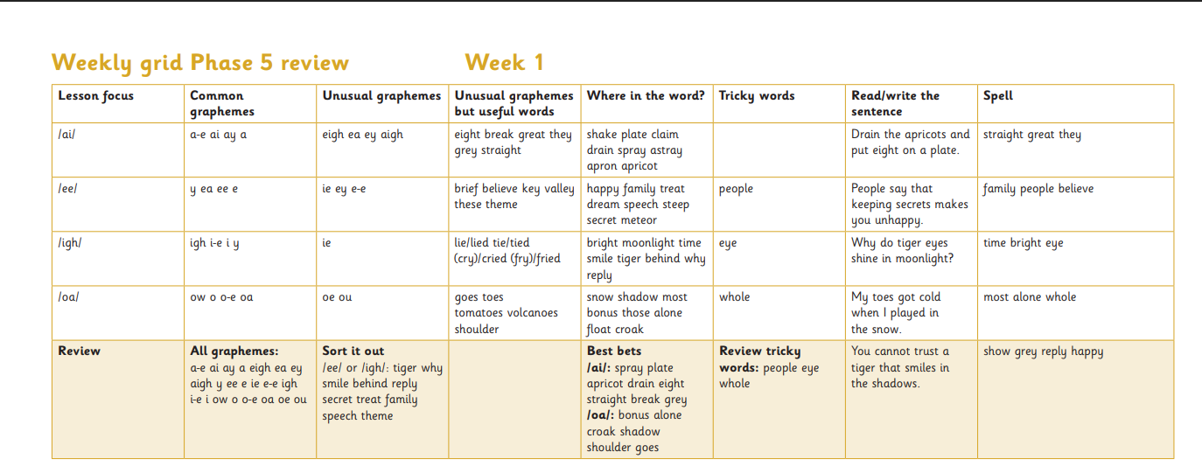
Phonics
We teach phonics daily using a scheme called Little Wandle.
What a session look like.
Year 2 Spellings – We aim for children to become fluent and confident spellers.

Slide 7
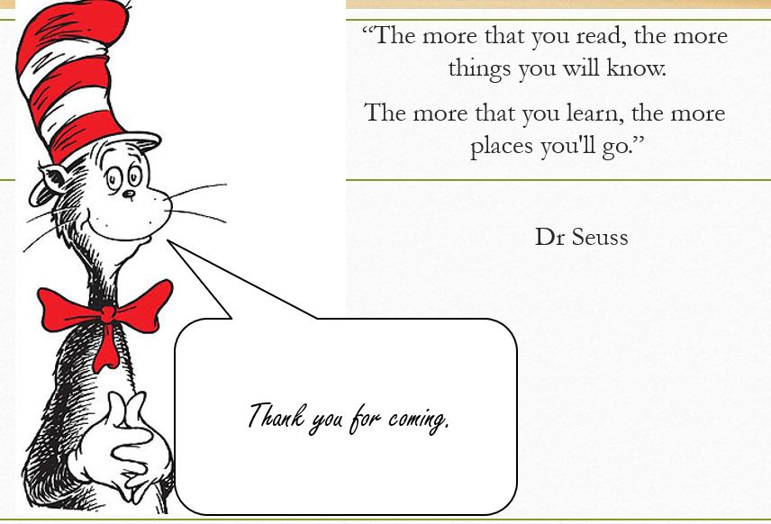
Reading
Within the Little Wandle Reading scheme your child reads three times a week. The books the children read reinforcing the phonics we are learning that week. Once your child has read three times the book will come home.
Your child should be familiar with the book.

Slide 8
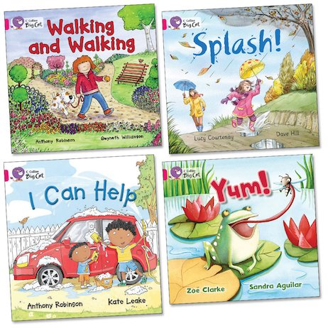

Reading
It is essential that as parents and carers we understand the importance of home reading and how to support your child’s reading in a positive and enjoyable way. Investing time to develop reading relationships between home and school is crucial. At Fowlmere, we provide a balance of books to send home for early readers, including:
• A reading practice book matched to your child’s phonic stage that they can read independently.
•The children will also bring home another book which we call “Reading for pleasure”. This will be a book of your child’s choice from our school library to share, talk about and enjoy with you.
Reading book: Please read and discuss the book with your child. Questions to ask your child will be at the back of the book. They should be able to read the word fluently by silent blending in their head and saying the word, as well as recognising tricky words.

Slide 9
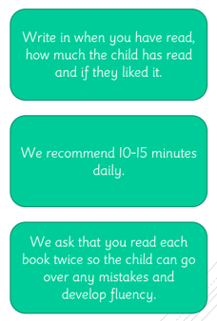

We will change our reading books every Friday to the book we have read that week in our guided reading sessions. This is so the children can practise the reading skills they learned during the week. E.g. decoding, prosody and comprehension.

Slide 10
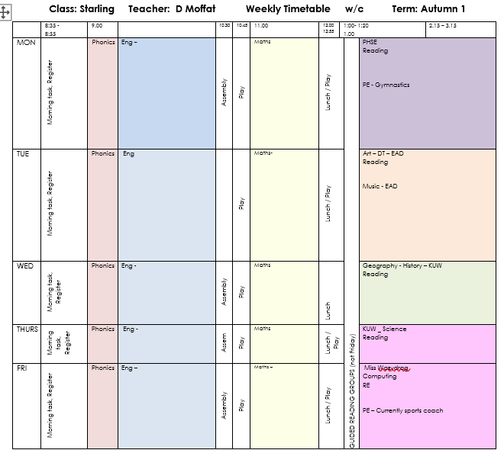
Our class timetable

Slide 11
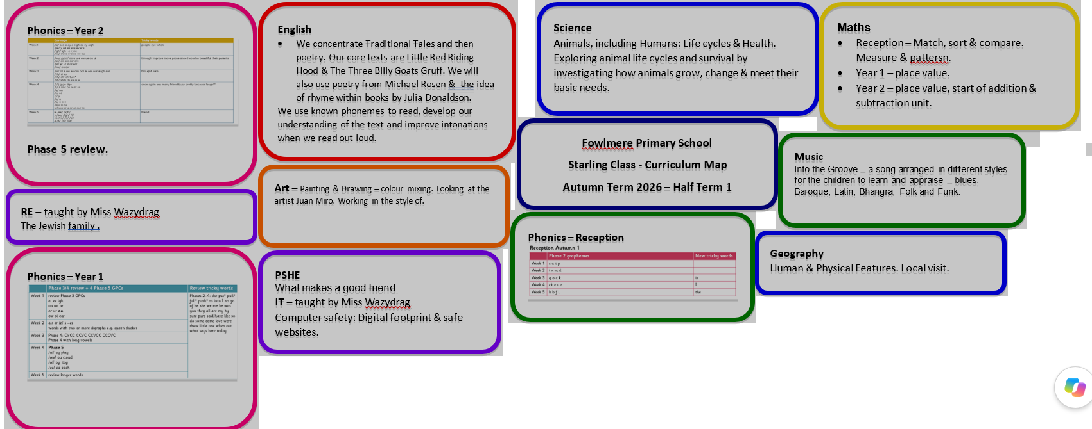
This half term your child will be learning.
CurriculCurriculum map
This half term the children will be learning:
undoum map
This half term the children will be learning:

Slide 12
How can you support your child at home.
EYFS
Self care – To get undressed and dressed independently as well as put on their shoes.
To write their name.
To count, sort objects and begin to recognise numbers to 10.
To read with your child every day for 10 minutes.

Slide 13
How can you support your child at home.
Year 1/2
To read daily for 10 – 15 minutes and discuss what is happening in the book.
Can they predict what will happen next.
What is the character like? How do you know?
Where is the story set?
Which was your favourite part of the story? Why?
To support your child with spellings phonics and spellings.

Slide 14
Communicatio
Communication is vital.
Please continue to communicate and inform us of anything that you feel we should know. However small you feel it might be! Early mornings is always so busy and a tricky time of the day.
If you can please try and catch me after school. I’m happy to have a chat or if you would like a more private chat please ring or email the office.
Tel: 01223 712447
Email: office@foxton.cambs.sch.uk

Slide 15
Safeguarding
Safeguarding Lead – Mrs Muir
Deputy Safeguarding Leads – Mrs Brooks & Mrs Morris.

Slide 16
Headteacher Newsletter
The Headteacher Newsletter is a great way for parents to see what activities have taken place or are planned.
Newsletter

Slide 17

Thank You!

