Slide 1

Goldfinches Class
Years 3/4
Curriculum Meeting
17th September 2026
Teachers: Mrs Morris and Ms Wazydrag (P.P.A on Thursday p.m.)

Slide 2

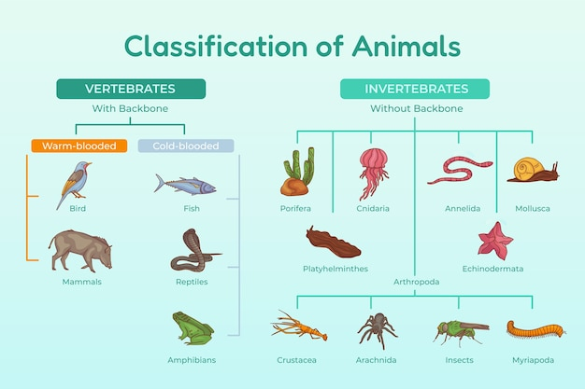

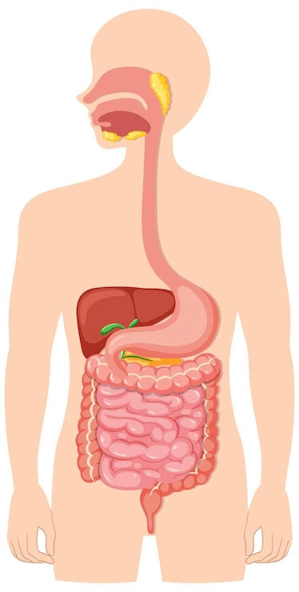







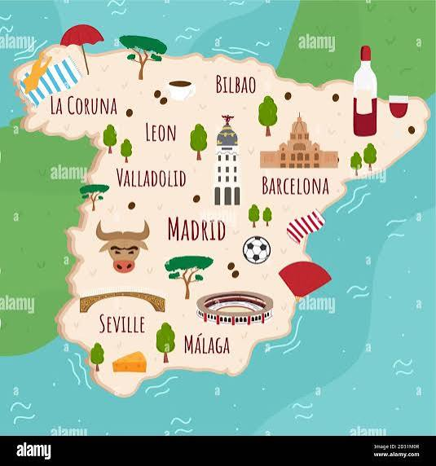

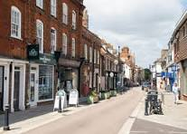

Some of our topics for this year…

Slide 3
















Some of our key texts
for this year…

Slide 4
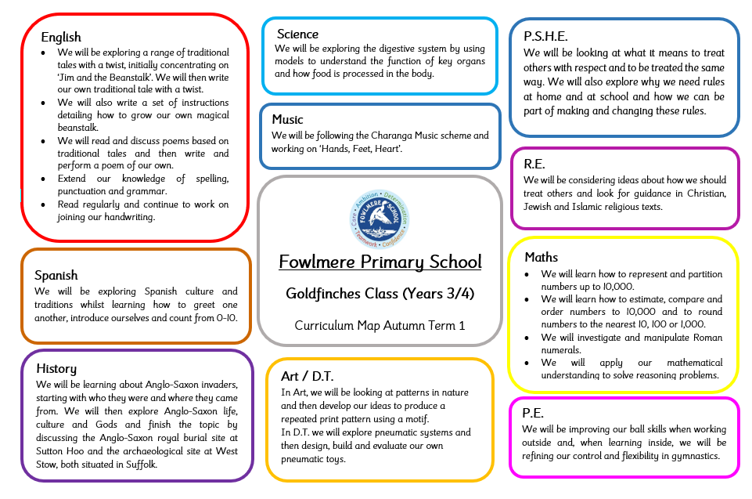
Half termly planning
Can be found on the school website on the Goldfinches Class page.

Slide 5
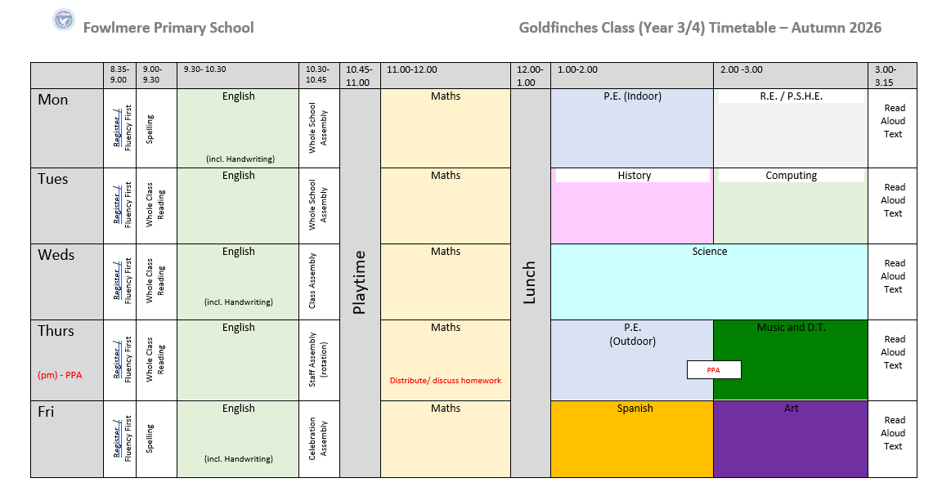
Weekly Class Timetable

Slide 6
Daily routine
8.35 – Children come into class and complete fluency tasks (maths and spelling) / Register
9.00 – Spelling lesson (Monday and Friday)
Whole class reading (Tuesday / Wednesday / Thursday)
9.30 - English
10.30 – Assembly
10.45 - Playtime
11.00 – Maths
12.00 – Lunch
12.30 – Lunch break
1.00 – Afternoon lessons
3.15 – Home time

Slide 7
P.E.
P.E. is on Mondays and Thursdays.
P.E. kit to be in school every day throughout the week although it can obviously be brought home in the afternoon, washed and returned the next day if necessary.
No earrings please on P.E. days and long hair to be tied back.
Sports footwear and warm clothing is needed.
Water bottles / snacks
Please ensure that your child has a full water bottle in school every day and a healthy snack too if required.
PLEASE LABEL EVERYTHING!

Slide 8
Homework
Spelling Shed – to be set and checked weekly.
Times Table Rockstars – to practice at home.
Reading at least three times a week - please make a note (or encourage your child to make a note) in their reading record of the pages that they have read.
Goldfinches ‘Homework Book’ tasks.
Creative homework due date this half term: week beginning 19th October

Slide 9
Multiplication Tables Check for Year 4s
A short, on-screen digital assessment designed to check Year 4 pupils' ability to recall times tables up to the 12x table (no related division facts.)
The test has 25 questions, each displayed for 6 seconds, and takes less than 5 minutes to complete.
The test is statutory for all year 4 pupils in state funded schools.
Pupils cannot pass or fail as there is no official pass mark.
Multiplication check window opens on Monday 7th June 2027 and is open for 2 weeks.

Slide 10
Safeguarding
Safeguarding Lead – Mrs Muir
Deputy Safeguarding Lead – Mrs Brooks

